Slide 1
Ch - 5
Tree

Slide 2
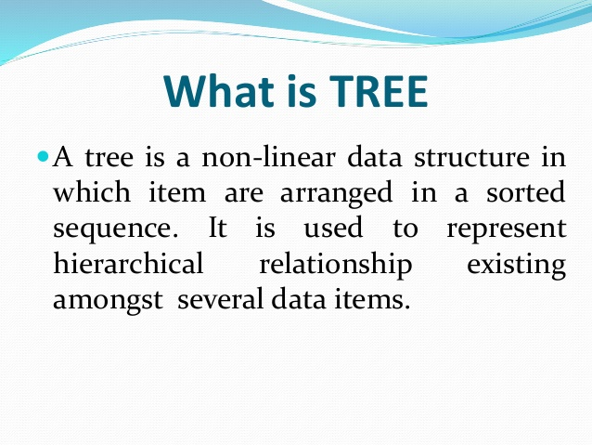
Overview Tree

Slide 3
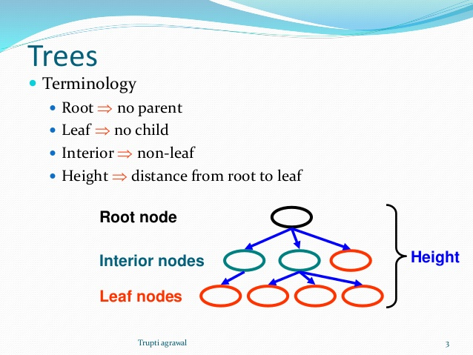

Slide 4
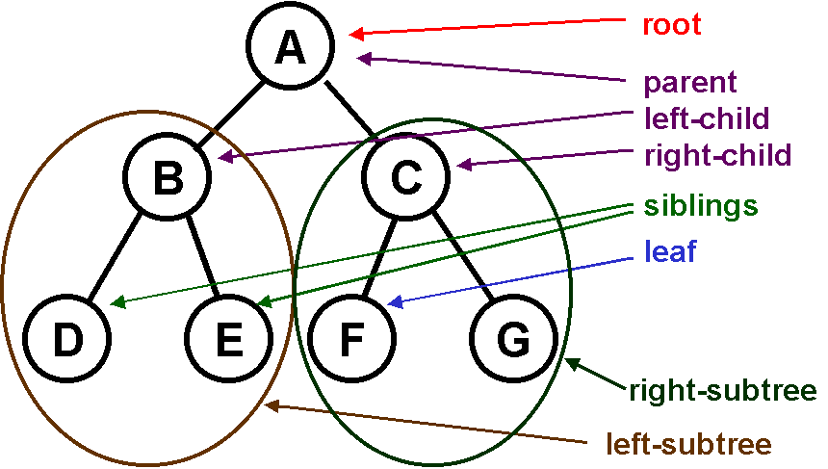

Slide 5
binary tree
A binary tree is made of nodes, where each node contains a "left" reference, a "right" reference, and a data element. The topmost node in the tree is called the root.

Slide 6
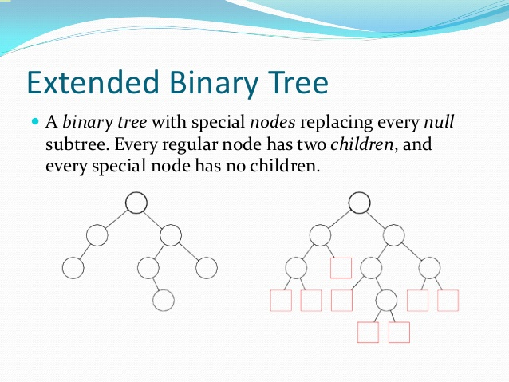

Slide 7
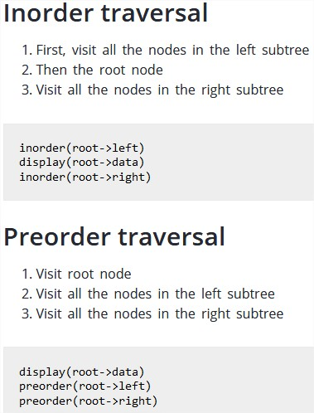
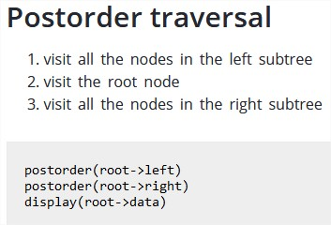
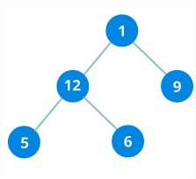
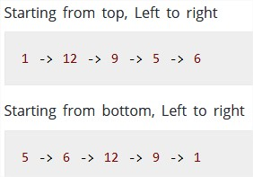
types of traversals binary tree

Slide 8
